Slide 1
Using Deep Learning to Detect Altered Faces
Leveraging AI & Optical Flow Analysis for Video Integrity

Slide 2
01
Introduction

Slide 3
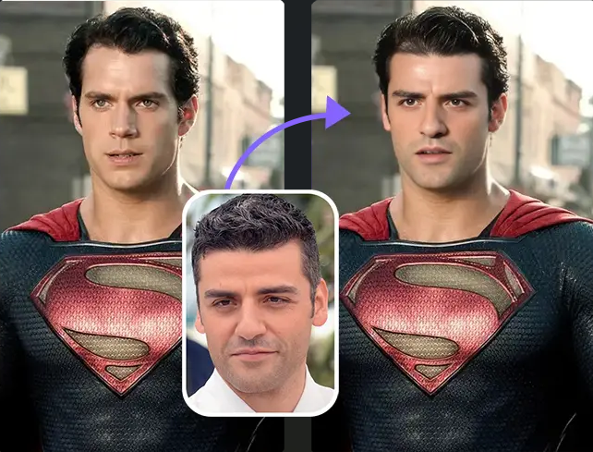
Deepfake technology overview
Deepfake technology employs artificial intelligence to create realistic-looking fake videos. By using deep learning techniques, it generates content that mimics real human features and actions, posing significant challenges in identifying authenticity.

Slide 4
Impact of deepfakes
The rise of deepfakes has major implications for misinformation, fraud, and breaches of privacy. As these technologies improve, they can affect public opinion, financial security, and trust in media.
As deepfake videos become increasingly sophisticated and pervasive, the question arises: How can artificial intelligence be utilized to combat this growing threat and protect digital integrity?

Slide 5
02
Problem

Slide 6
Threats in cybersecurity
Deepfake videos represent a significant threat in cybersecurity. They can be used for social engineering attacks, impersonating individuals, and undermining the credibility of digital content.

Slide 7
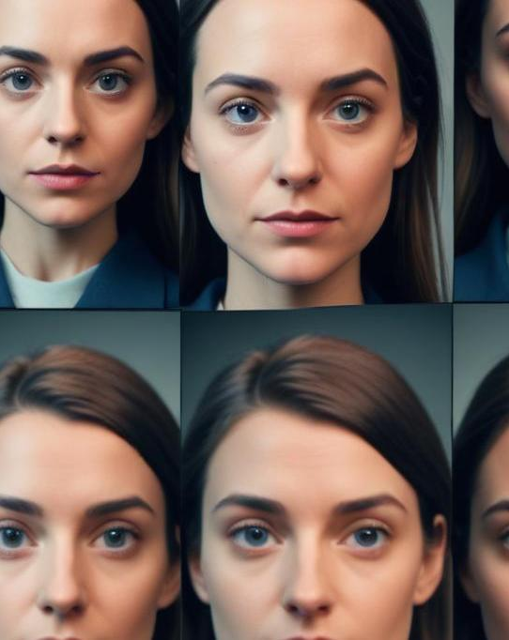
Research indicates that deepfake technology is increasingly used for malicious purposes, particularly in face-swapping applications that contribute to misinformation. Studies show that a significant portion of deepfake videos involve swapping faces of public figures, such as politicians and celebrities, to create deceptive content. For instance, a UK-based study found that 34.1% of respondents had encountered deepfake videos featuring politicians, a common method for spreading disinformation. Additionally, face-swapping deepfakes have been used in manipulated news footage and fabricated interviews, making them a powerful tool for misinformation campaigns. As concerns over digital deception grow, understanding and detecting face-swapping deepfakes is becoming increasingly crucial.

Slide 8
03
Solution

Slide 9
Why AI?: Deep learning excels at finding complex patterns in videos, like unnatural movements or face distortions, which are hard for humans to spot.
Dataset: Used 300 videos (150 real, 150 fake) from a Faceforensics.
Real videos: Genuine recordings of people.
Fake videos: Altered faces in videos of real people.
Feature Extraction: Extracted key clues from videos to help the AI:
Facial Landmarks: Points on the face (e.g., eyes, nose) to track shape and movement.
Optical Flow: Motion between frames to detect unnatural changes.
Deep Features: Patterns from a pretrained AI model (EfficientNet).
Frame Differences: Changes between frames to spot inconsistencies.

Slide 10
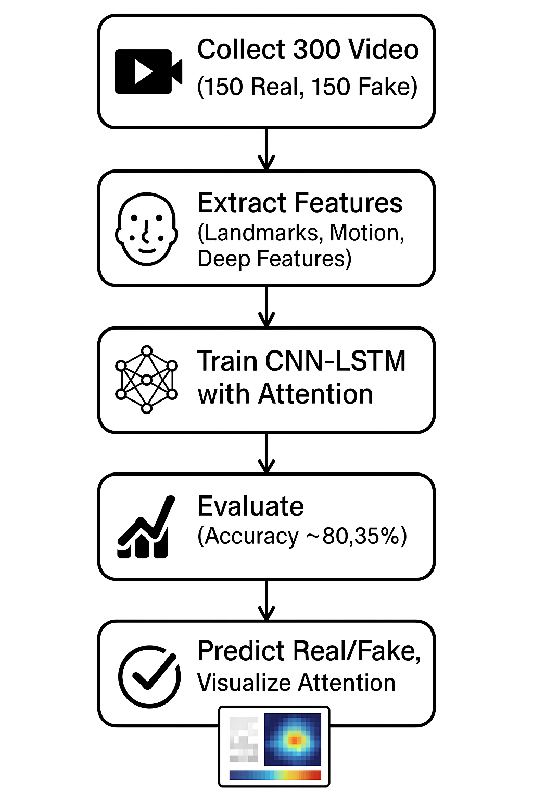
Workflow overview
The project follows a five-step workflow to classify videos as real or fake using Deep Learning. First, we collected 300 videos (150 real, 150 fake) from a Faceforencins dataset. Next, we extracted features like facial landmarks, motion (optical flow), deep patterns (from EfficientNet), and frame differences to capture deepfake clues. Then, trained a CNN-LSTM model with an attention mechanism on a Kaggle GPU, using data augmentation to improve robustness and early stopping to prevent overfitting. Finally, I used the model to predict new videos, visualizing attention weights to show which frames influenced the real or fake classification.

Slide 11
04
Model

Slide 12
Model Architecture
The network architecture for my deepfake detection project is a combination of three key components: a Convolutional Neural Network (CNN), a Long Short-Term Memory (LSTM) network, and an attention mechanism, designed to analyze video frames and classify them as real or fake. The CNN acts like a detective, examining each video frame to extract details such as face textures or patterns, producing a set of features that describe what’s in the frame. These features are then passed to the LSTM, which is like a memory expert, tracking how these features change across multiple frames to capture movements, such as how a face shifts over time. This combination is crucial because deepfakes often have subtle inconsistencies in frame details or unnatural movements that the CNN and LSTM can detect together.

Slide 13
The attention mechanism enhances the model by focusing on the most important frames, helping it prioritize moments where deepfake clues, like odd facial twitches, are most noticeable. After the LSTM processes the sequence of frames, the attention mechanism assigns weights to each frame, highlighting those that matter most for the final decision. These weighted features are then fed into a final layer that outputs a prediction: “real” or “fake.” This architecture, trained with 300 videos, allows the model to learn complex patterns in video data, achieving moderate accuracy (80.35%) despite challenges like distinguishing fake videos. The attention weights also provide a visual way to see which frames influenced the model’s decision, making the results easier to understand.

Slide 14
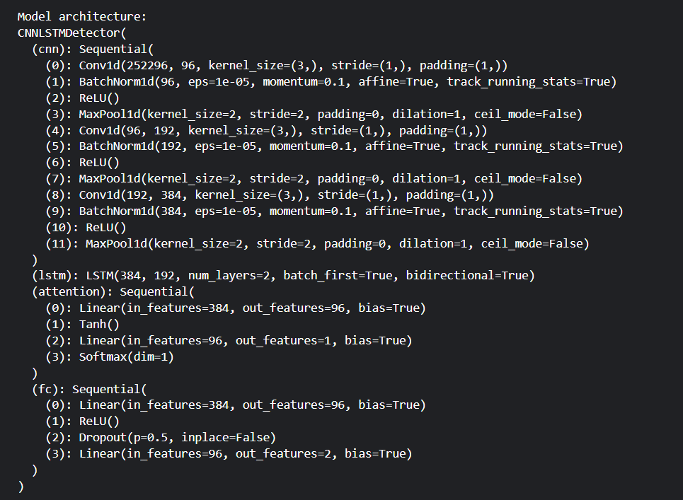

Slide 15
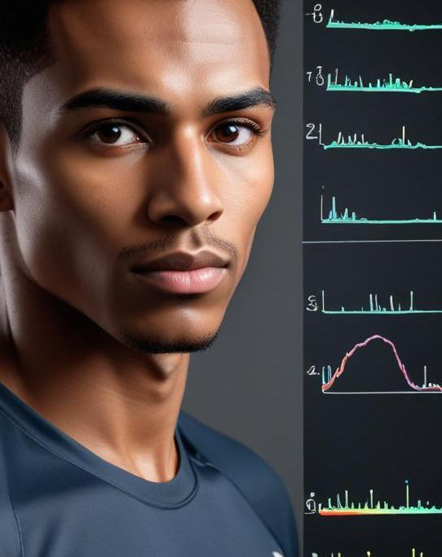
Training parameters
The training parameters for the model were carefully set to help the CNN-LSTM with attention learn effectively from 300 videos (150 real, 150 fake). We used a learning rate of 0.0001 to adjust the model’s weights gradually, trained for up to 20 epochs (iterations over the data), and applied early stopping after 3 epochs without improvement to prevent overfitting. Data augmentation, like flipping or rotating frames, made the model robust to different video conditions. Class weights (1.3 for real, 1.0 for fake) balanced predictions, and a weight decay of 0.00005 reduced overfitting by penalizing large weights, resulting in a model with 80.35% test accuracy despite challenges with fake video detection.

Slide 16
Evaluation metrics
To evaluate my deepfake detection model, I tested it on a test set (20% of 100 videos, ~14 videos) using key metrics to measure its ability to classify videos as real or fake. The model achieved an accuracy of 80.35%, correctly predicting 80% of the videos, but misclassified three, mainly fakes as real. Precision of 83.33% shows that 83% of videos predicted as fake were truly fake, ensuring good reliability. Recall of 71.43% indicates that 71% of actual fake videos were identified, missing two fakes. The F1 score of 76.92% balances precision and recall, reflecting solid but improvable performance. An AUC-ROC of 93% suggests the model is effective at distinguishing real from fake, guiding future tweaks to reduce misclassifications.

Slide 17


Slide 18
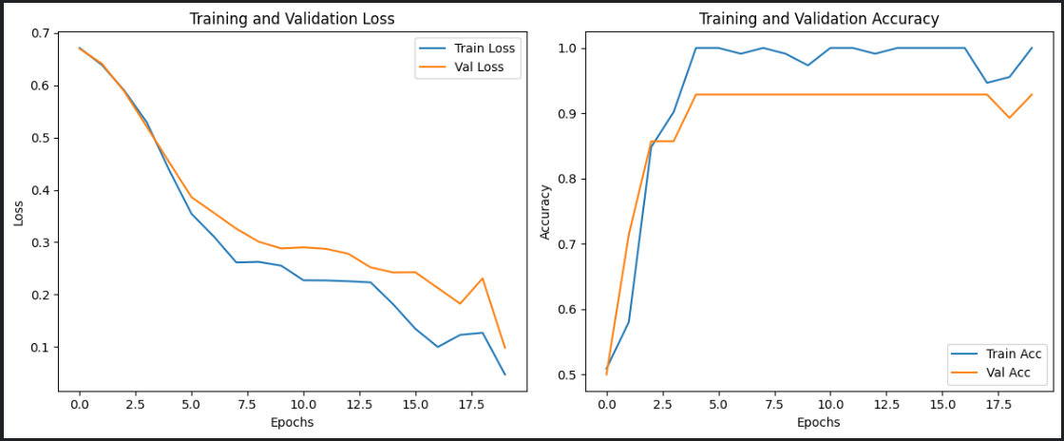

Slide 19
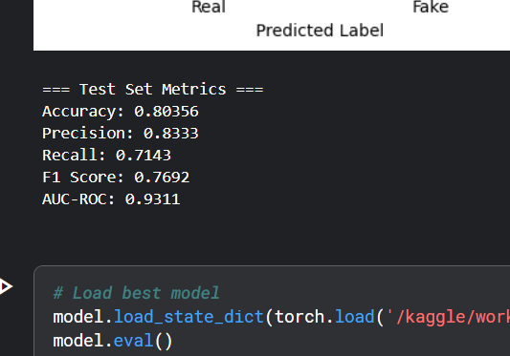

Slide 20
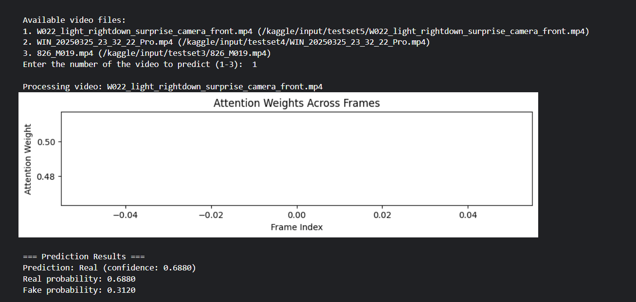

Slide 21
05
Challenges

Slide 22
Video quality variability
Variability in video quality presents a major challenge, as deepfakes can be created using different techniques and resolutions. Low-quality videos may be harder to analyze accurately, affecting the model's performance.
Real-time processing needs
Real-time detection of deepfakes requires high-speed processing capabilities to analyze videos as they are being recorded or streamed. This demands optimizations in the model architecture for performance efficiency.
Dataset limitations
Limited datasets can lead to biases and reduced model accuracy. Expanding datasets with diverse and varied examples of deepfakes and real videos is essential to train robust models capable of handling different scenarios.

Slide 23


Conclusions
This deepfake detection project successfully developed a deep learning model to distinguish real videos from fake ones, using a combination of frame analysis, motion tracking, and attention to focus on key moments. Despite challenges, such as occasionally mistaking fake videos for real, the model effectively identified deepfake patterns by analyzing features like facial landmarks and movement. This work demonstrates the potential of artificial intelligence to combat misinformation through automated video analysis. With additional data and improved techniques, the model could become even more reliable, contributing to solutions for real-world deepfake challenges

Slide 24
Thank you!

